Slide 1

The System of Nation-States

Slide 2
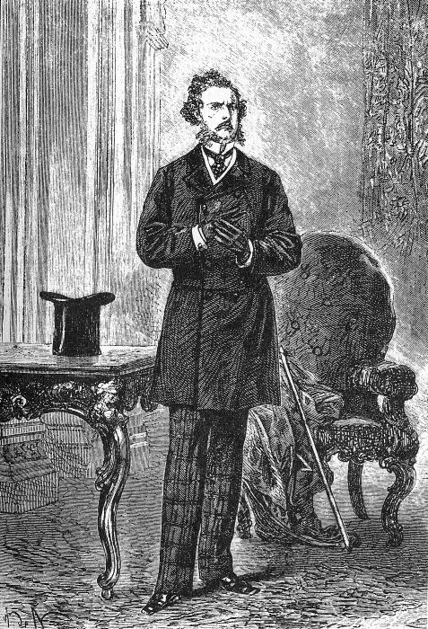
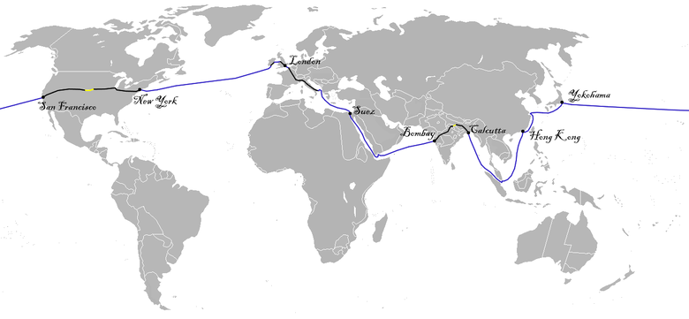
Around the World in 80 Days

Slide 3
From Integration to Interdependence

Slide 4
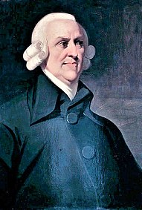
From Mercantilism to Free Trade
Mercantilist period (16th-18th centuries) expanded trade through monopoly over colonies
Adam Smith, Wealth of Nations (1776) posited general benefits of free trade
David Ricardo, Principles of Political Economy (1817) advanced free trade ideology with theory of comparative advantage
British textiles dissolved pre-commodity economies and linked people into world trade

Slide 5
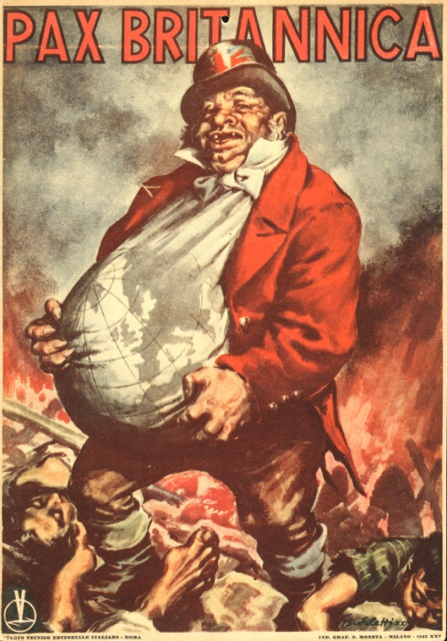
The Pax Britannica
British commercial hegemony and naval superiority secured following defeat of Napoleon
“One hundred years’ peace” saw few direct conflicts among European powers
Britain promoted multilateral free trade, and completely abandoned protectionism in 1846
1800-1840: World trade roughly doubled
1850-1870: World trade increased by 260%

Slide 6
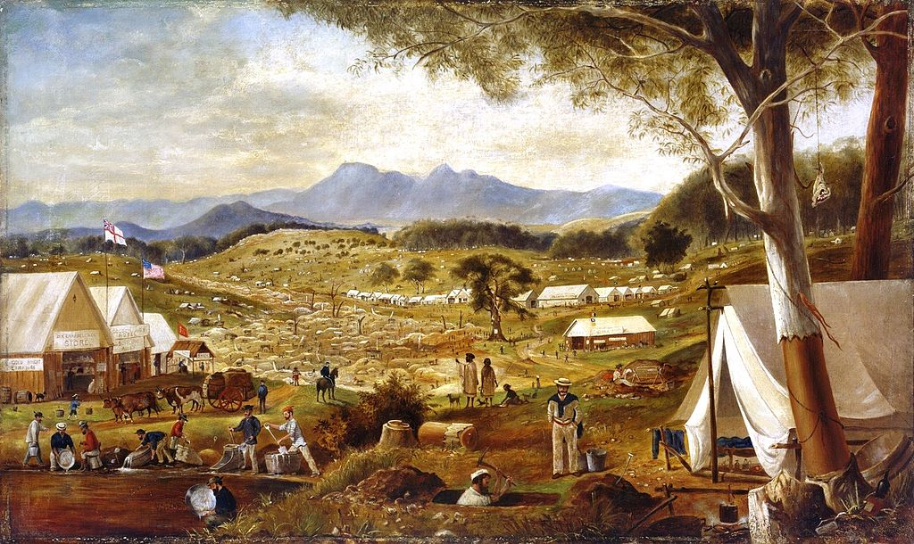

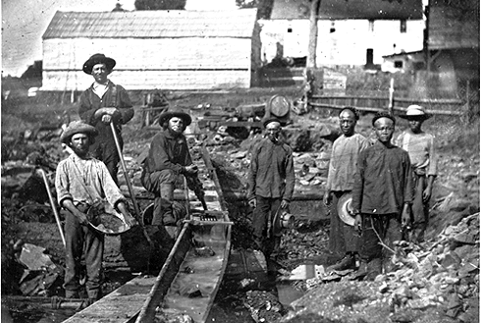

Gold Standard
British Empire formally adopted Gold Standard in 1821
1849-1851 saw new infusions of gold into world economy from California and Australia
Modern banking practices became measure of fiscal soundness, prerequisite for capital flows

Slide 7

International System of Nation-States
Formed under hegemony of British Empire
Undergirded by transnational division of labor
Mid-nineteenth century boom finalized commodification, transition to capitalism
Backlash expressed in nationalism, traditionalism, and populism
Capitalist transition required modern states to mediate social dislocation, administer development of internal market, and navigate diplomatic terrain

Slide 8

State Building and Industrial Growth
Germany
The United States
Japan
Russia

Slide 9
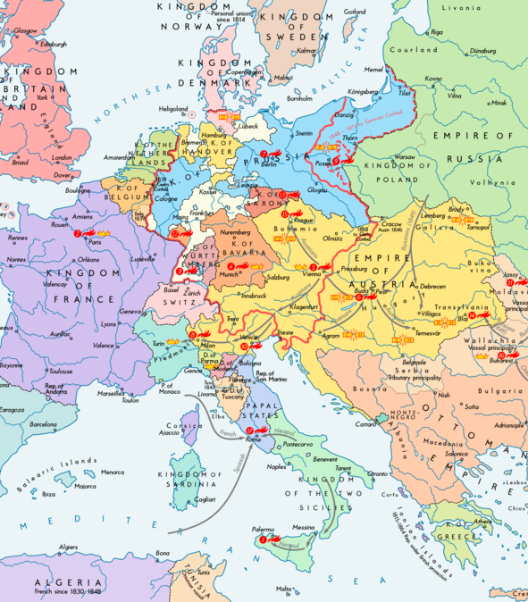
European Revolutions of 1848

Slide 10
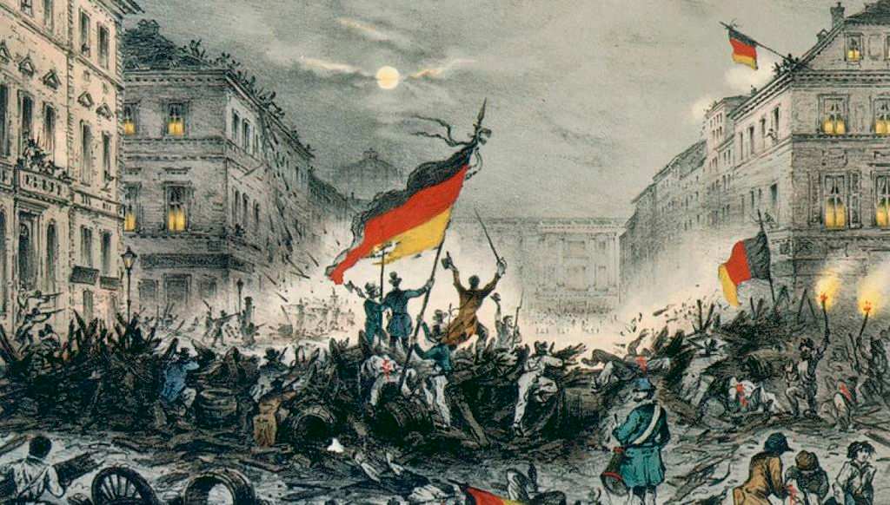
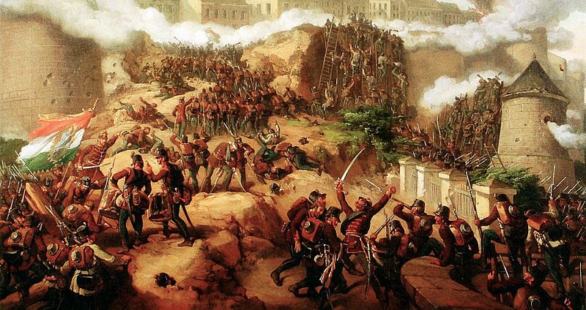
Springtime of the Peoples
Urban and rural poor reacted to their social conditions
Bourgeois and middle-classes unhappy with monarchic restoration
Civil Wars fought out in urban streets
Ended in failure, but changed the course of European history by stirring nationalism

Slide 11
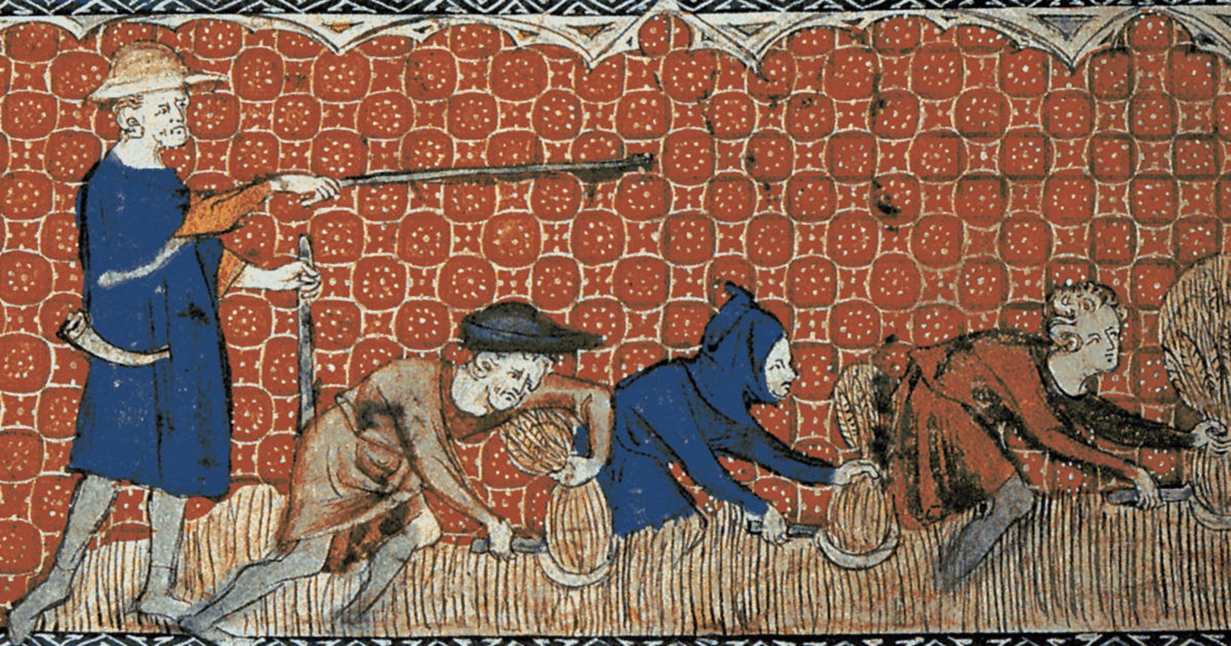
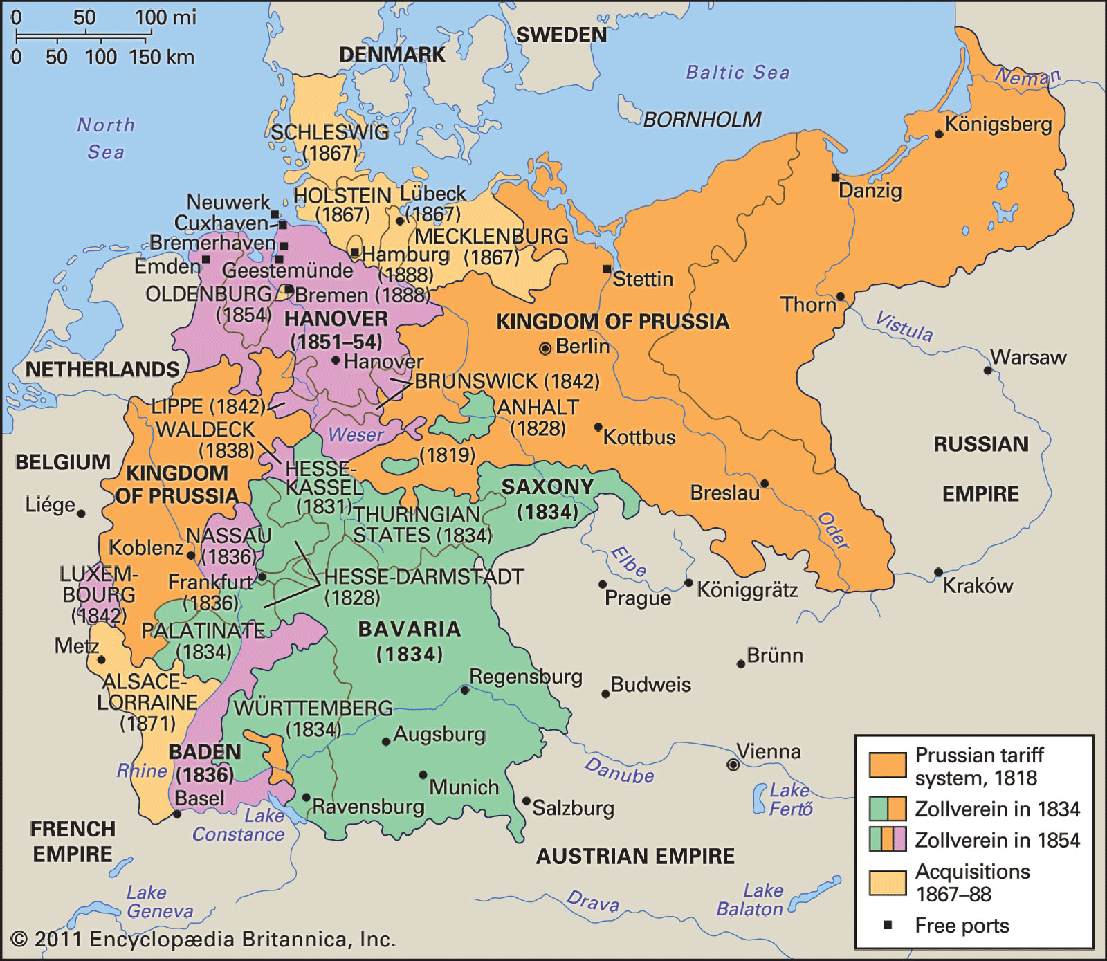
Pre-Industrial Germany
German Confederation replaced Holy Roman Empire in 1815
Kingdom of Prussia instituted tariffs in 1818
Advantages: natural resources such as coal; world-class education system
Disadvantages: durable feudal relations, including serfdom
Zollverein unified German Kingdoms in a custom union with free internal trade and external protections

Slide 12
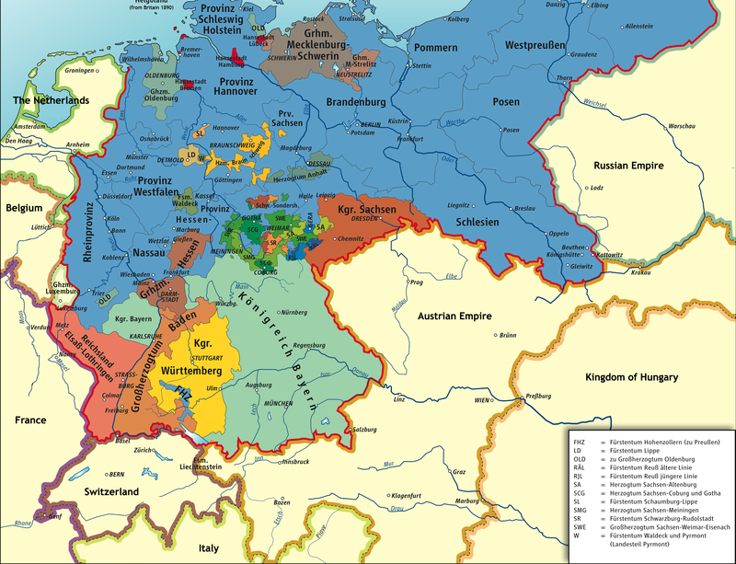
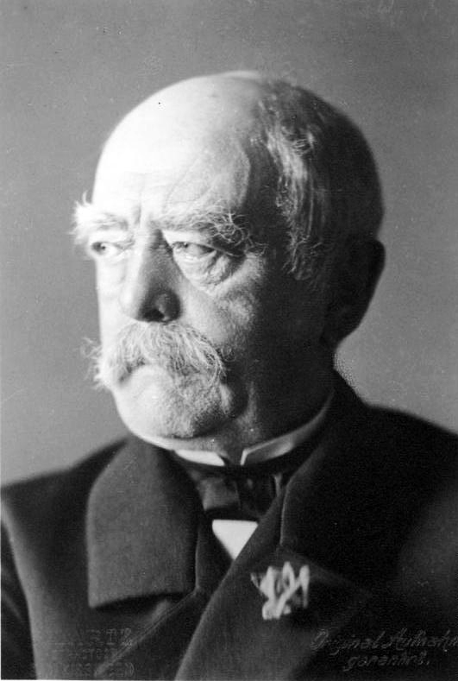
German Unification
During feudal ages, German-speaking people occupied over 300 polities within Holy Roman Empire
German nationalism surged under Napoleonic occupation
Otto von Bismarck negotiated German unification following the Franco-Prussian War 1871

Slide 13
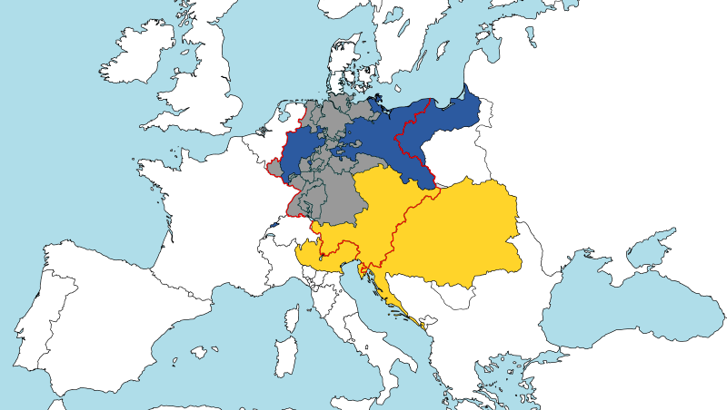
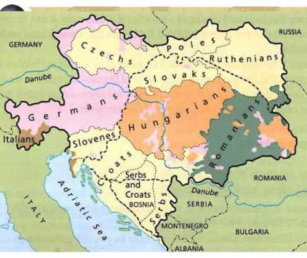
German Nationalism
Pan-Germanism gained momentum during Napoleonic Wars
German Confederation of 1820 included Austrian and Prussian Empires
Bismarck succeeded in unifying “Lesser Germany”

Slide 14
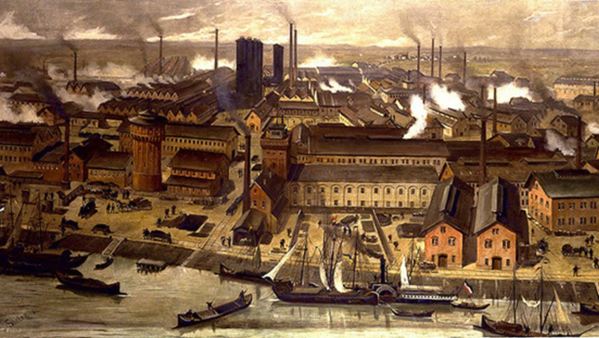
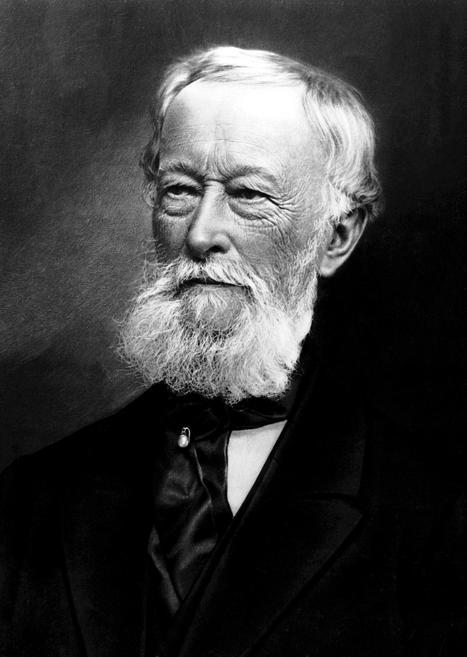
German Industrialization
The protectionist Marriage of Iron and Rye, 1879
Heavy tariffs on Iron, Coal, and Steel helped fuel industrial development
Krupp family at the center of steel cartel
Became world leader in chemicals

Slide 15
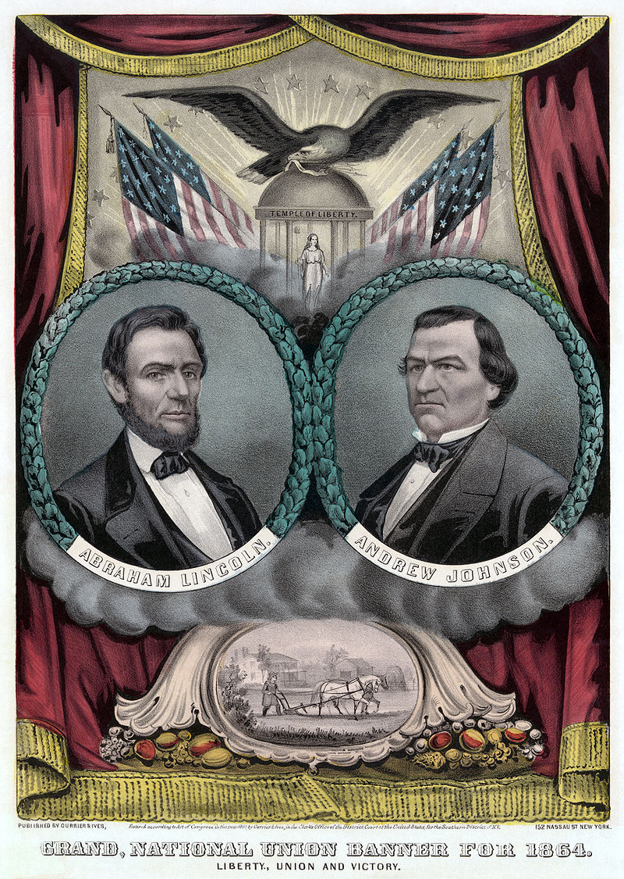
Economic Causes of the Civil War
Tariffs of 1828 and 1832 inflamed the sectional crisis
Republican Party brought together Northern Whigs, Free Laborites, and radical abolitionists
Throughout the 1950s, Republican Party steadily employed the rhetoric of slavery as economic stagnation

Slide 16
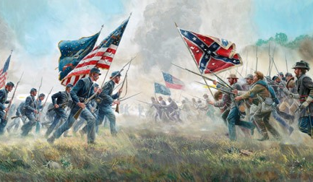
US Civil War in a Global Perspective
Causes: slavery yes, but also authority at the federal level
Ceased cotton exports, leading Britain to find other sources
Stalled development of the transcontinental railroad
Aftermath: expansion of the role of the federal government

Slide 17
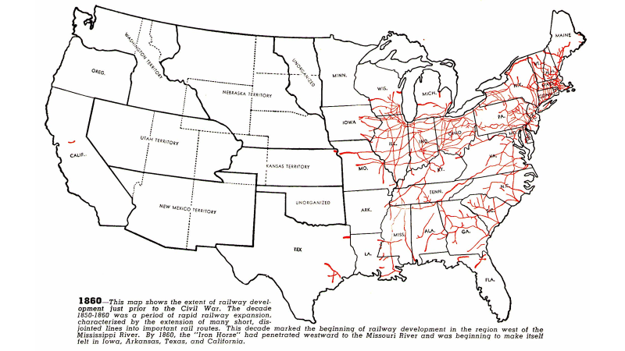

Slide 18
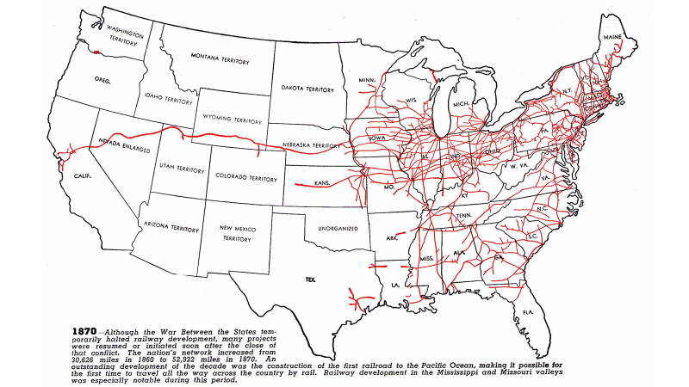

Slide 19
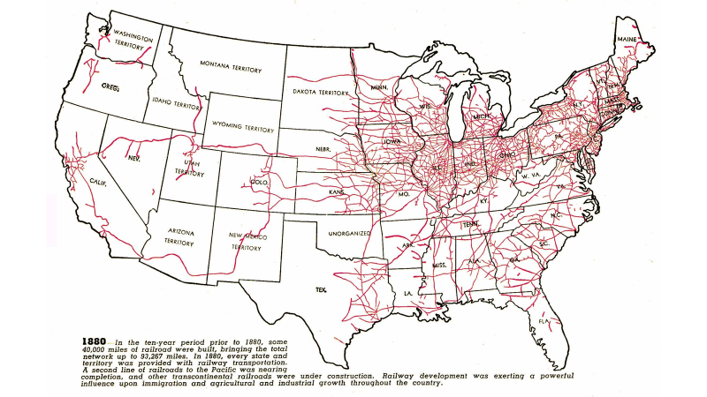

Slide 20
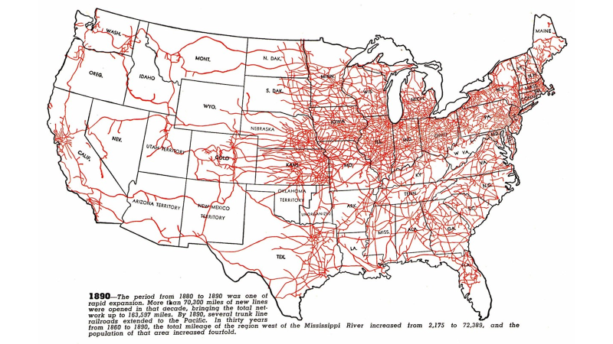

Slide 21
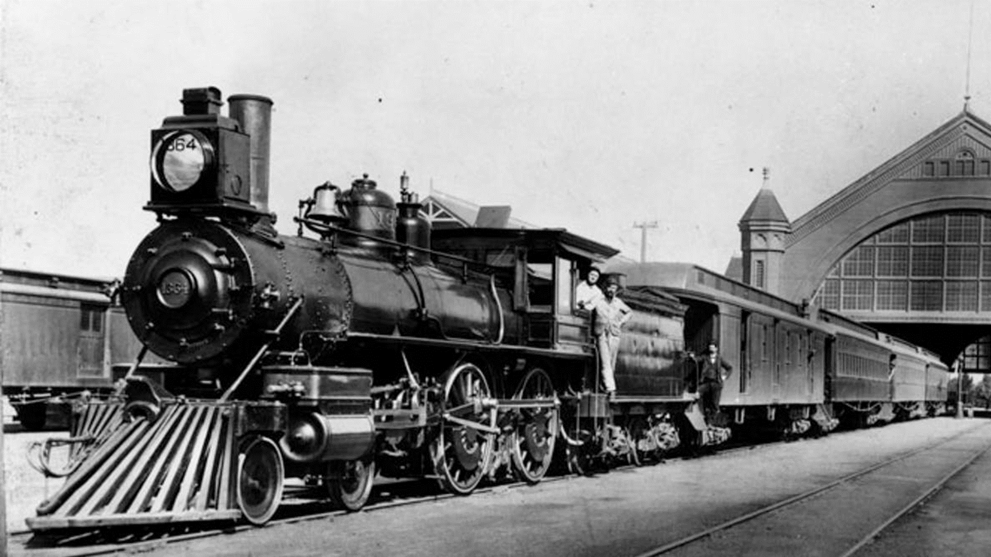
Significance of American Railroads
Investment outlet for European (especially English) capital
Unified the American state and fostered stronger national identity
The engine (pun intended) of US industrial growth

Slide 22
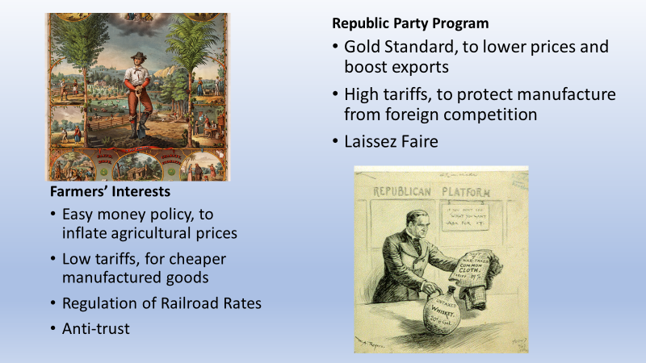
internally

Slide 23
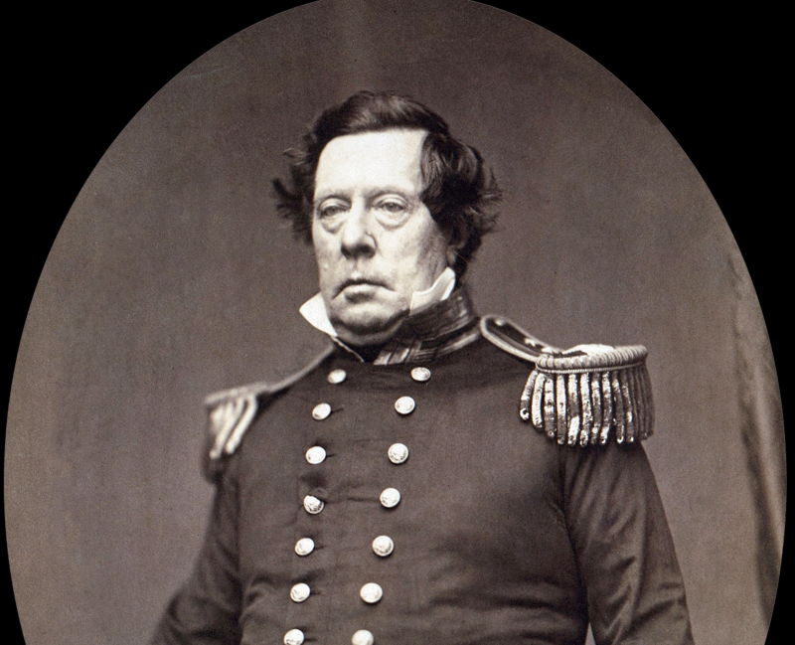
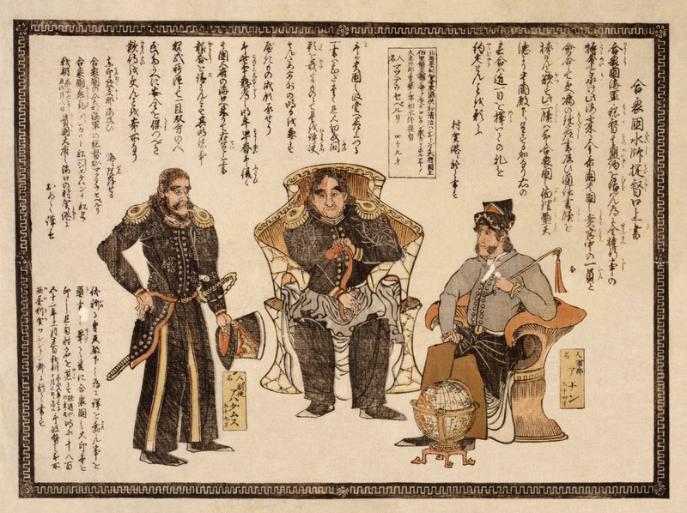
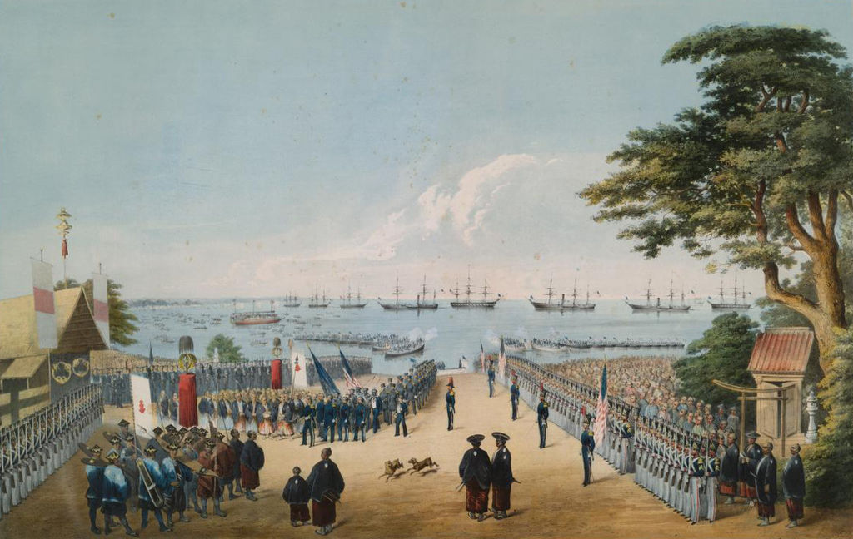
Opening Japan
Feudalistic Tokugawa Shogunate implemented sakoku, closed society much like Qing China
Matthew Perry sailed East India Squadron to force Japan to sign a trade treaty
Other industrializing powers soon followed
Elicited sharp anti-Wester response within Japan

Slide 24
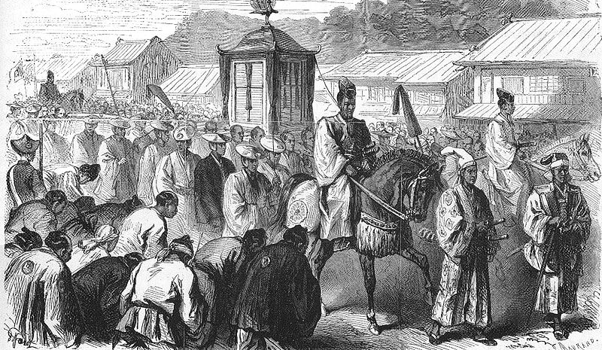
Meiji Restoration
Samurai reformers wanted to compete rather than retrench
Emperor Mutsuhito replaced Tokugawa Shogunate in 1868
Meiji Constitution established parliamentary monarchy, 1889

Slide 25
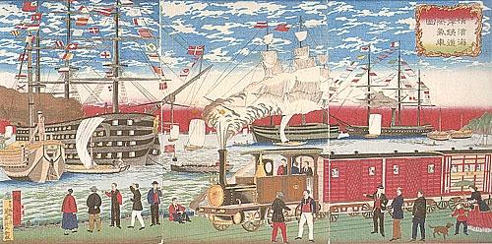
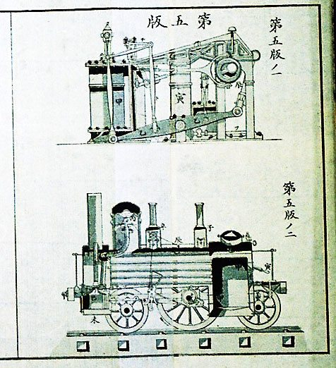
Japanese Industrialization
1871 Meiji Emperor effectively ended Japanese feudalism
Skipped competitive capitalist stage, went directly to large vertically integrated monopolies (zaibatsu)
Japanese scholars had long wanted to industrialize, and kept abreast of technological change
Cheap labor and domestic iron production were enough to get started

Slide 26
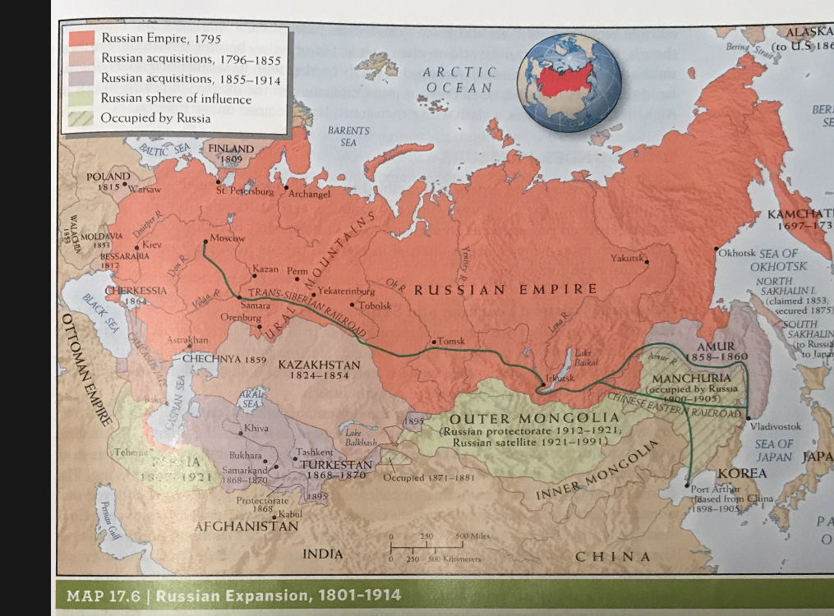
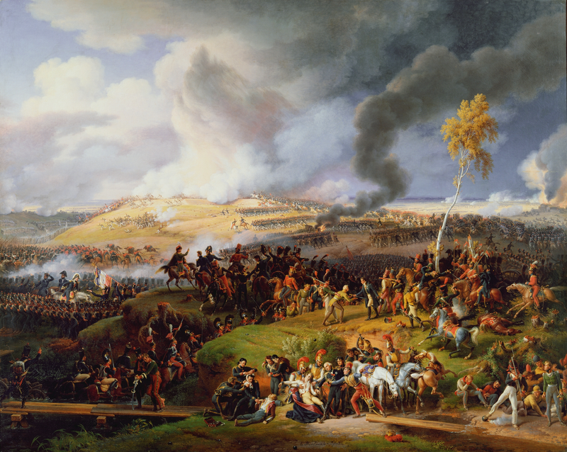
The Russian Empire
Behind the West in agriculture and territory expansion in the eighteenth century
Made territorial gains in Europe at Congress of Vienna, 1815
Remained absolutist, feudal, and agrarian for first half of nineteenth century
Despite liberal reformist sentiment, Tsar Nicholas I promoted policy of Orthodoxy, Autocracy, and Nationality

Slide 27
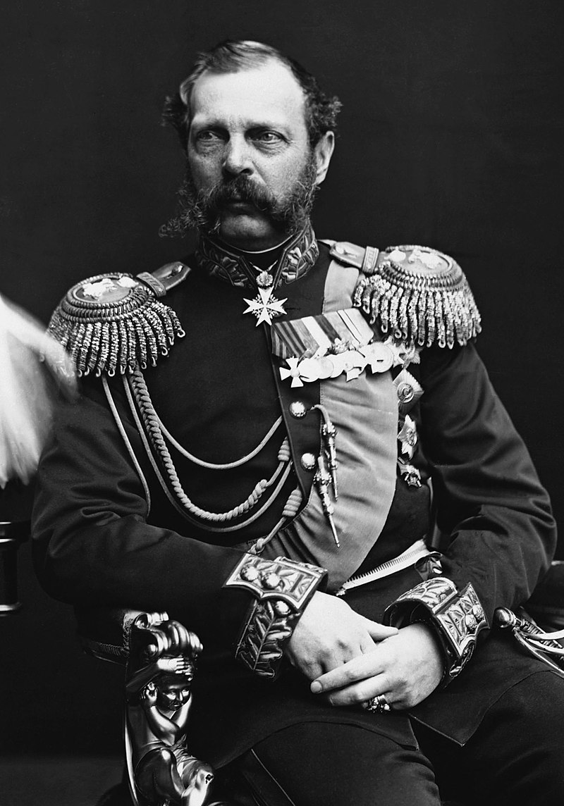
Reform from Above
Tsar Alexander II abolished serfdom and enacted reforms to protect property rights and expand the administrative state
Alexander III continued economic reforms, but clamped down on political dissent

Slide 28
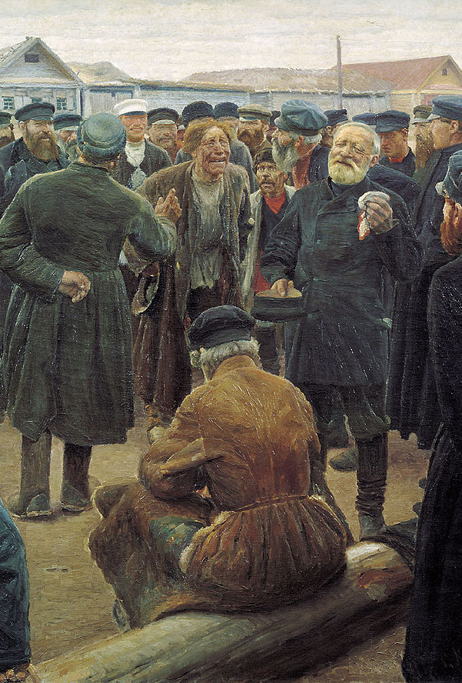
Narodnaya Volya
Russian populist movement
Led by intellectuals
Grew among recently freed serfs
Premised on Russian nationalism and exceptionalism of Obshchina, a form of peasant communalism

Slide 29
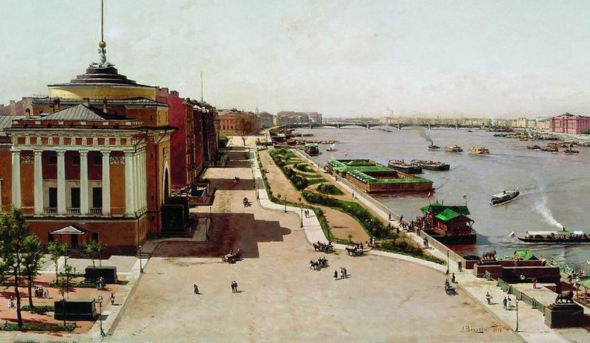
Russian Industrialization
Population doubled between 1850 and 1910, fastest of any industrializing states except U.S.
Continued to lag behind the west industrially until early twentieth century
Small pockets of urban industry in St. Petersburg, Moscow and Russian Poland

Slide 30
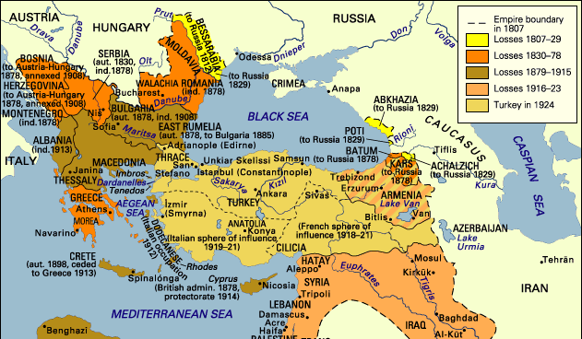
Erosion of the Ottoman Empire
Multi-ethnic Ottoman Empire began to lose regions to nationalist revivals
Also under constant pressure from Russian Empire

Slide 31
International Dynamics of the Emerging System
Industrialization spurred by a combination of interdependence and competition
Modern states grew under the pressure of international competition
Nationalism legitimized the centralization, concentration, and expansion of political authority
Spread of industrialization smoothed uneven development, leading to inter-imperialist competition

